Slide 1
Arrays of Objects
Carole McGloughlin
Frances Sheridan

Slide 2
What is wrong with Arrays?
Absolutely, nothing.
However, there are limitations.
You need to define how much space is needed at the start.
If you need a larger one, then you need to create an additional array.
If you need a smaller one, then you have allocated too much space which can slow your program down.

Slide 3
What is an ArrayList?
An ArrayList is a growable array of objects.
It contains components that are accessed via their index.
The size of an ArrayList can grow and shrink as needed to accommodate adding and removing items after the ArrayList has been created.

Slide 4
ArrayList
Flexible and Dynamic
Unlike arrays, which are available to use in every class, we need to import the ArrayList class before using it
Fix Imports will import the correct class in Netbeans.
import java.util.ArrayList;

Slide 5
ArrayList Methods
A comprehensive list of available methods for ArrayLists can be found in the Java API:
http://docs.oracle.com/javase/6/docs/api/java/util/ArrayList.html
The term API mean Application Programming Interface
It is like the instruction manual for Java and is available for most if not all classes.

Slide 6
Declare ArrayList
An ArrayList needs to be both declared and created before use.
To declare an array list of Employee objects we do the follow:
ArrayList<Employee> list;
We must give the list a name that we will refer to it by
Start with the keyword ArrayList
Note: the object is placed inside angle brackets: < >

Slide 7
Create ArrayList
An ArrayList needs be created.
list = new ArrayList<Employee>();
As with all creations, the keyword new is used.
Note: the object is placed inside angle brackets: < >
Both the keyword ArrayList and class name constructor are used for creation.

Slide 8
Adding an Object to an ArrayList
Once you have a new ArrayList of objects created, you can add elements to it with the add method.
With object you add all the attributes to a single object and add the entire object to the ArrayList
ArrayList<Employee> list = new ArrayList<Employee>();
Employee e = new Employee(name, id);
list.add(e);

Slide 9
Size of an ArrayList
The number of objects in an ArrayList is determined using the size method.
int sizeList;
sizeList = list.size();
System.out.println(“There are ”+sizeList+“elements in the array list”);

Slide 10
View individual object in an ArrayList
To view an individual object, we first pop the object from the ArrayList using the get method.
We then can look at the individual attributes.
The get method requires us to know the index of the object in question.
// look at the 10th object in ArrayList
Employee e = list.get(10);
String name = e.getName();
int id = e.getId();

Slide 11
Search an ArrayList is a modification of Viewing
To search an ArrayList for an individual object, we pop the objects in turn from the ArrayList using the get method and compare to some value, such as name.
For example, search Employee list for name Peter.
Employee e;
for (int i=0; i<list.size();i++){
e = list.get(i);
if (e.getName().equals(“Peter”)){
System.out.println(“We have found a match”);
System.out.println(“Name: “+e.getName()+ “EmpId: “+e.getId());
}
}

Slide 12
Remove an Object from an ArrayList
To delete or remove an object from the ArrayList we use the remove method.
We need to know the index of the element we are going to remove.
// remove the 5th object from the ArrayList
list.remove(5);

Slide 13
Worked Example – Employee App contd.
REFRACTOR PACKAGE NAME
Our worked example is a modified version of the EmployeeArrays application.
Copy the EmployeeArrays folder and paste and rename as EmployeeArrayLists
Open EmployeeArrayLists in Netbeans
Expand the project, right click on the package name and go to refractor -> rename
Rename to employeearraylists

Slide 14
EmployeeGUI
Most of the changes will happen in the EmployeeGUI class by editing the source code.
CHANGE 1
Comment or delete the array declaration at the top and replace with
//Employee [] emp;
ArrayList<Employee> empList;

Slide 15
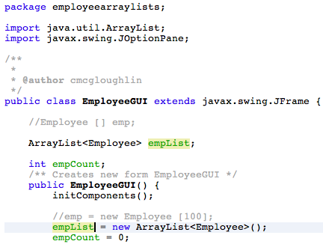
EmployeeGUI
CHANGE 2
Comment or delete the array creation in the constructor and replace with:
//emp = new Employee [100];
empList = new ArrayList<Employee>();
You will notice that ArrayList is underlined in red.
Right click on it and scroll down to Fix Imports.
This is add the correct import statement at the top of program and the red lines disappear.

Slide 16
Amend relevant ActionPerformed Methods
In our previous worked example, we add buttons to do the following actions:
Add an Employee
View all Employee
Search for a particular Employee
Delete an Employee
The ActionPerformed Methods for each of these needs to be amended to use the Array List instead of the Array of Objects.

Slide 17
Add an Employee
CHANGE 3
The easiest way to navigate to the addJBActionPerformed method is to go to the Design palette and double click on the Add Button.
Most of the method remains unchanged, however instead of adding the object to the array of object we amend to add to the ArrayList
//emp[empCount] = e;
//empCount++;
empList.add(e);

Slide 18

Add an Employee
The object e is automatically added into the last available spot in the ArrayList. We don’t need to worry about incrementing the empCount at this stage.
The rest of the method remains unchanged.

Slide 19
View All Employees
CHANGE 4
First we need to know the current size of the ArrayList.
We get the current employee object from the ArrayList and save it into our temporary Employee e object using the get method. The following change should be made
empCount = empList.size();
// e = emp[i];
e = empList.get(i);

Slide 20
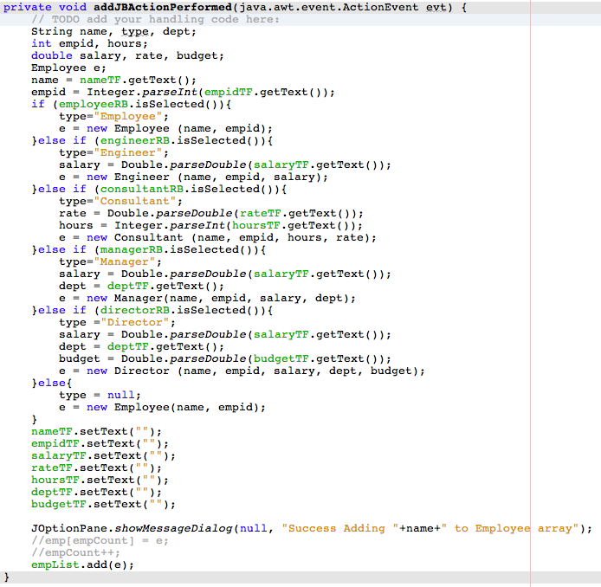
View All Employees

Slide 21
Search for an Employee
CHANGE 5
First we need to know the current size of the ArrayList.
Inside the for loop (nested inside the if statement we amend the following piece of code):
empCount = empList.size();
// e = emp[i];
e = empList.get(i);

Slide 22
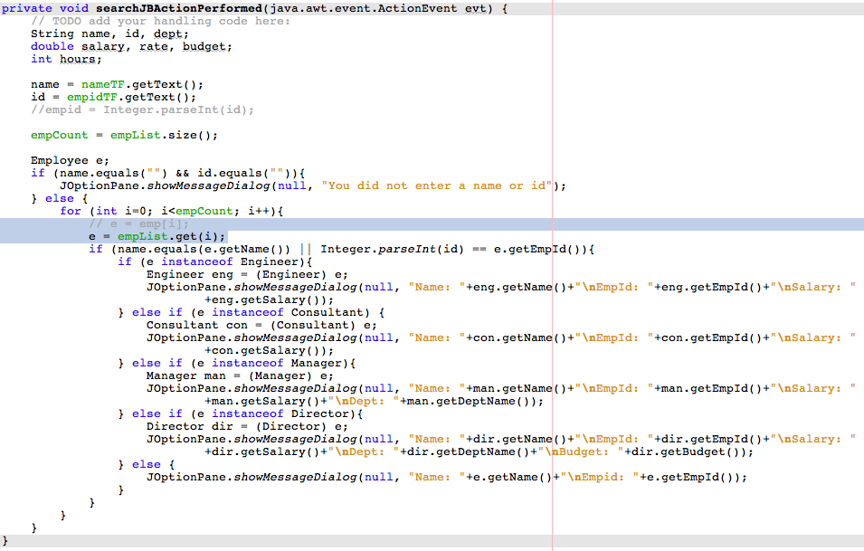
Search for an Employee

Slide 23
Delete an Employee
CHANGE 6
First we need to know the current size of the ArrayList.
Inside the for loop (nested inside the if statement we amend the following piece of code):
Inside the following if statement, we need to change the following code to actually remove the unwanted object:
empCount = empList.size();
// e = emp[i];
e = empList.get(i);
//emp[i] = emp[empCount-1];
//emp[empCount-1] = null;
//empCount --;
empList.remove(i);

Slide 24
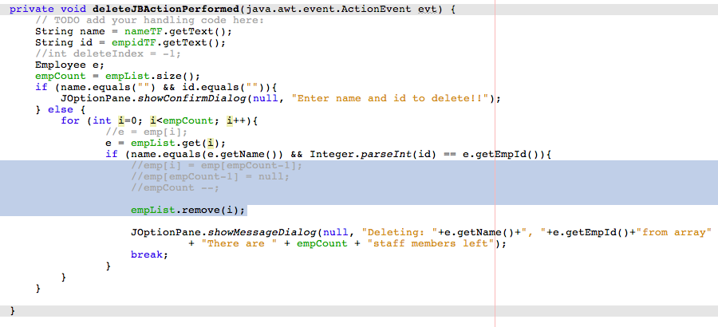
Delete an Employee

